Slide 1
A Shape Preserving Approach to Image Resizing
Guo-Xin Zhang¹ Ming-Ming Cheng¹ Shi-Min Hu¹ Ralph Martin²
¹Department of Computer Since and Technology, Tsinghua University, China.
²School of Computer Science, Cardiff University, UK.
Presented by Ming-Ming Cheng in Pacific Graphics 2009
Notes:
Good afternoon ladies and gentleman. I’m Ming-Ming Cheng from Tsinghua University. My presentation topic is “A Shape Preserving Approach to Image Resizing”.

Slide 2
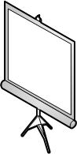

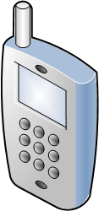



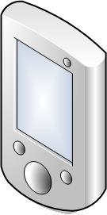
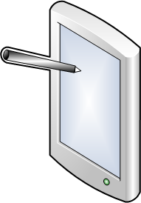


Content aware image Resizing
Display devices with widely differing resolutions as well as aspect ratios.
Notes:
With the rapid growth of multimedia techniques, display devices have widely differing resolutions as well as aspect ratios.

Slide 3
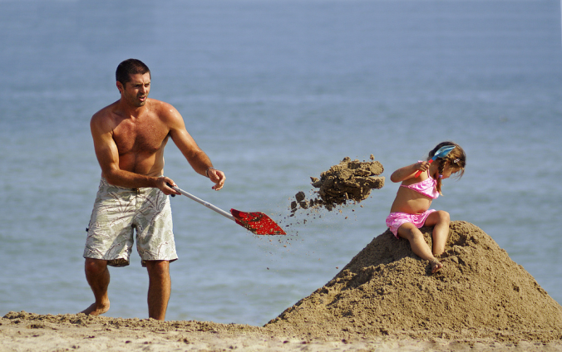

Content aware image resizing
Display devices with widely differing resolutions as well as aspect ratios.
Content aware image resizing.
Scaling
Notes:
When resizing an image to fit a display device with a very different aspect ratio, traditional uniform scaling methods would cause significant distortion of image content as shown in this figure. Content aware image resizing aims at this problem, that is how to resize existing images to fit the display devices, without distorting the important features too much.

Slide 4
A hot field
Concurrent works
Pacific graphics 2009
Optimizing Structure Preserving Embedded Deformation for Resizing Images and Vector Art
Siggraph Asia 2009
A System for Retargeting Streaming Video
Motion-Aware Temporal Coherence for Video Resizing
Optimized image resizing using seam carving and scaling
Symposium on Geometry Processing 2009
Energy-Based Content-Aware Shape Deformation
Notes:
Content award image resizing is a very hot field and has many related publications. Here is a list of some concurrent works including 1 paper in PG, 3 papers in Siggraph Asia and 1 paper in SGP.

Slide 5
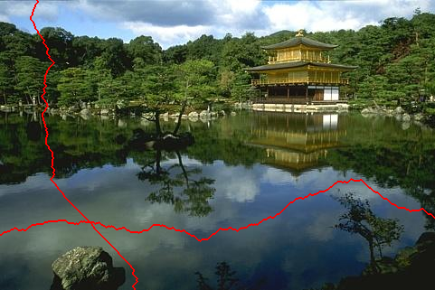
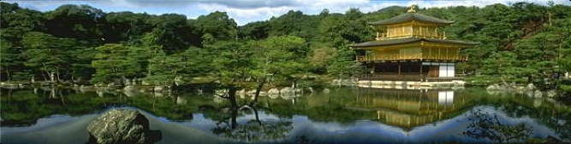
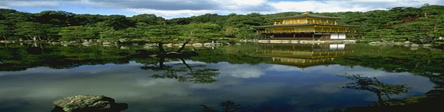
Previous works
Seam carving
The most famous image resizing method
A seam in an image is a contiguous one-dimensional path of pixels from top-to-bottom, or side to side, each having locally minimal importance.
An online demo
http://swieskowski.net/carve/
Notes:
The pioneer work of this field is the seam carving method proposed by Avidan and Shamir in Siggraph 2007. They define a seam to be a contiguous 1D path of pixels from top-to-bottom or side-to-side, each having local minimal importance. This method produces impressive results and inspires many other works for content aware image or video resizing. However, the discrete nature of this method may cause many jags for structural objects.

Slide 6
Previous works
Non-homogeneous content-driven video-retargeting [Wolf 07]
Offer continuous solutions to image resizing by non-uniform warping.
Shrinkability Maps for Content-Aware Video Resizing [Random work 08]
Shrinks less important pixels in the reduction direction
Feature-aware texturing [Gal 06]
Warps an image in a way that locally constrains the deformations to be similarity transformations.
Notes:
Here are some other related works. Non-homogeneous content-driven video-retargeting offers continuous solution to image resizing by non-uniform warping. Shrinkability maps for content-aware video resizing shrinks less important pixels in the reduction direction. Feature-aware texturing warps an image in a way that locally constrains the deformations to be similarity transformations.

Slide 7

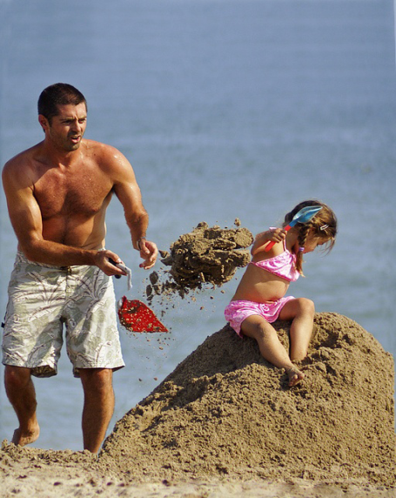
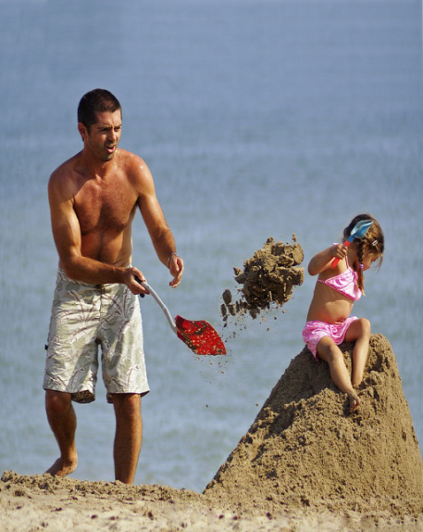
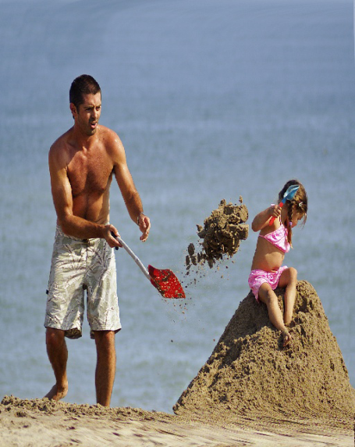
Previous works
Methods that propagate distortions in one direction
The distortion can not be well diffused
Fail if the important information to be retained is wider than the destination size.
Input image
Seam Carving
Wolf
Random walk
Gal
Notes:
However, these methods only propagate distortion along the resizing direction. The distortion can not be efficiently diffused. They will fail if the important information to be retained is wider than the destination size. In this figure, the width of the important objects, including the man and the girl, is even wider than the destination image size. All this kind of method fail to give good result for this reason.

Slide 8
Previous works
Work in all directions
Optimized Scale-and-Stretch for image resizing (OSS)
Only preserving local similarities.
Result by OSS
Mesh by OSS
Notes:
Wang et al. proposed the optimized scale-and-stretch method for image resizing. It allows distortions to be diffused in all directions and has the advantages of distributing distortion over the whole image. Here, with the reduction of width, the height of the man is simultaneously reduced to keep the man more similar to its origin. However, it only preserves local similarities. Different quads from a same object may share different scaling factors, making the results look unnatural. In this example, each mesh quad over the man are similar to its origin but the quads at head area have bigger scale factors than those at the leg area. This makes the man looks very strange in the resulting image.

Slide 9
Basic Idea
Associate the input image with a set of handles. (A handle is a subset of control points)
Define an energy measuring the shape deformation of handles.
Minimize weighted sum of total deformation energy and require more important areas to be better preserved.
Find the target image according to the deformation of handles.
Notes:
Our basic idea can be briefly explained as follows. We associate the input image with a set of handles. Each handle is a subset of control points. An energy function measuring the shape deformation of handles will be defined after that. Then, we minimize a weighted sum of total deformation energy and require more important areas to be better persevered. The target image will be found according to the deformation of handles.

Slide 10
Basic Idea
Control points: mesh vertices + edge points
Handles: a subset of control points.
Notes:
We resize images according to the deformation of control points. These control points includes mesh vertices and edge points.
Three kinds of handles are defined to preserve both local image features and global image features.
Q-Handle: A Q-Handle comprises the four corners of a quad face which does not contain any additional control point. It is used to preserve local image features.
B-Handle: A B-Handle is an edge point set containing edge points belong to the same edge. In this figure, highlighted control points with the same color represent a B-Handle. For efficiency consideration, we choose one edge point which is nearest to the quad center for each quad. A B-Handle contains at least 3 control points. It’s used to preserve global image features since these edges often covers a large range of image area containing important objects.
K-Handle: A K-Handle is a set containing the four corners and the inner control point of a quad. Each K-Handle contains exactly 5 control points. It’s used to associate the local constrains and global constraints.

Slide 11
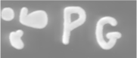


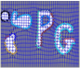

Algorithm Pipeline
Importance Map
Source Image
Handle Set
Deformed Mesh
Target Image
Target
Size
Notes:
The pipeline of our algorithm is shown here with a simple example. A set of handles are first associated with the source image. Each handle can represent a global image feature or a local image feature. This handle set is then deformed according to a weighted energy function which requires handles covering more important area to be more similar to their origin. Deformed mesh as well as target image can be find by minimizing this energy function.

Slide 12
Distortion Energy of Handles
Intuitive
It is the minimal possible square distance between two shapes P’ and P, if P may be replaced by any similarity transformation of itself.
We have proved that when P contains 3 points (P is triangle), this energy function is identical to the discrete conformal energy which is wildly used in geometry processing.
Notes:
This is our definition for the distortion energy. Intuitively, the energy measures the differences between two shapes while ignoring translation and rotation. In our case, it’s the deformed position and the original position, and is the minimal possible square distance between them. If the two shapes are similar, such measurement of shape differences is 0.
We have proved that when P contains 3 points, that is to say P is a triangle, this energy function is identical to the discrete conformal energy which is wildly used in geometry processing.

Slide 13
Distortion energy definition
If P is known, ε is quadratic on P’
The matrix formulation is
where:
Notes:
It is well-known that the similarity transformation has a linear representation in 2D, since P is known, it is easy to find that the energy is quadratic on the new handle positions P’.
If we represent them in matrix form, we have the following result. Notice that this energy function is quadratic on the unknown handle positions.

Slide 14
Relationship with the discrete conformal energy
If T is a triangle, T’ is its deformed position, then we have the relationship
is the discrete conformal energy, is a constant depending on T, and is invariant if T undergoes a similarity transformation. Thus, the distortion energy is closely related to the classical conformal energy.
Notes:
In this slide, we want to explain the relation shape with our method with the discrete conformal energy which is widely used in geometry processing. If T is a triangle, T’ is its deformed position. The conformal energy C(T’, T) equals to alpha T multiply our handle similarity energy. Alpha T is a constant only depending on the shape T. And it’s invariant if T undergoes a similarity transformation. Thus our distortion energy is closely related to the classical conformal energy.

Slide 15
The total energy constraint
Keep shape similarity + distortion energy + importance + global and local handles.
The total distortion energy is defined as
We get the deformed position by minimizing E
Importance
Distortion energy
Deformed position
Original position
Set of all Handles
Notes:
The kernel of our method lies on its attempt to keep the similarity of shape before and after deformation, and more important areas should be kept better. Such similarity is defined by this distortion energy:
Here, P is the set of all the handles, P and P’represents the positions of a handle before and after deformation, Epsilon is the distortion energy, and Omega is the importance given by input importance map
We can get the deformed handle positions by minimizing E.

Slide 16
Efficiency
As E is a quadratic function, we only need to solve the gradient matrix of E
P’ is the position of the deformed mesh
This is a sparse linear system, and solving it typically takes only about 0.024s for a 1024*754 picture.

Slide 17



Comparisons
Input image
Scaling
Our
Notes:
This figure compares our method with uniform scaling. Our result preserve the image feature significantly better than uniform scaling. Since the width of the conch in this figure is wider than destination image. Any resizing method operate only on one direction will fail since they can’t shrink the corn vertically.

Slide 18
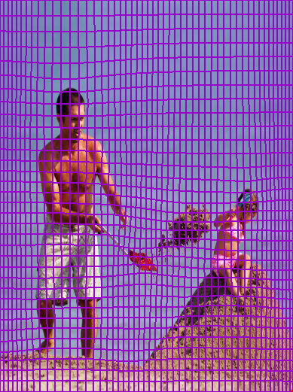
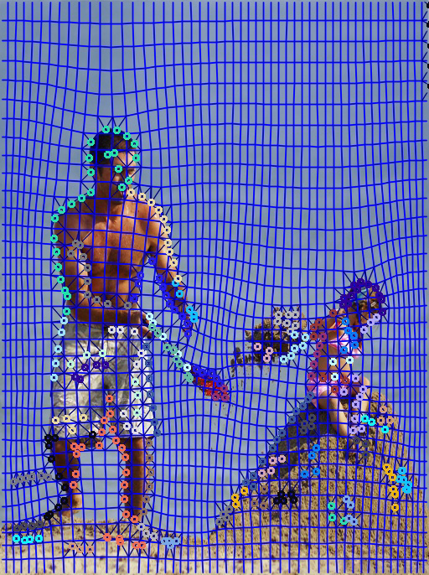
Comparisons
OSS
Our
Notes:
This figure compares our method with Optimal Scale-and-Stretch which resize image by propagate distortions in all direction. However, they use uniform mesh and require each edge to be undergo scaling transform. Local image features are preserved by iteratively solve an optimization problem. In comparison, we expect our features undergo similarity transform and preserve both local and global feature. Close form solution can be easily found by our method.

Slide 19
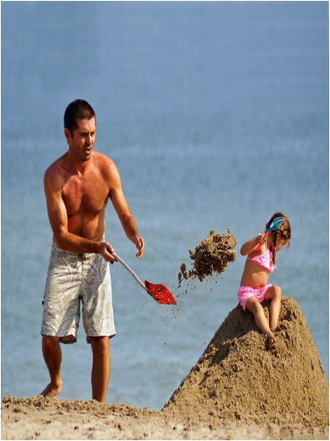
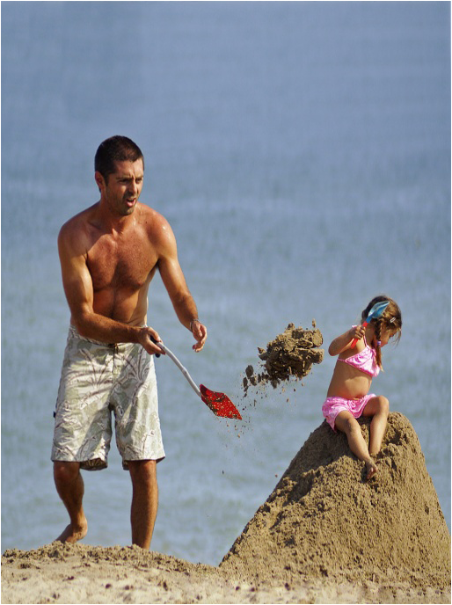
Comparisons
OSS
Our
Notes:
Here is the image associated with the handles shown in the previous slide.

Slide 20
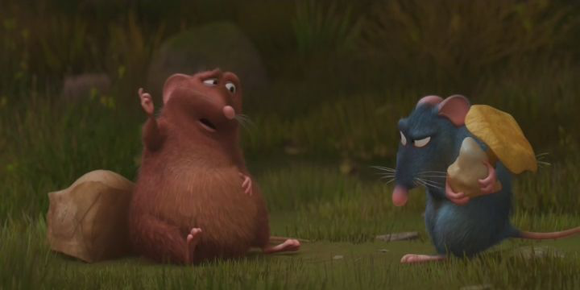
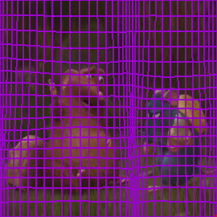
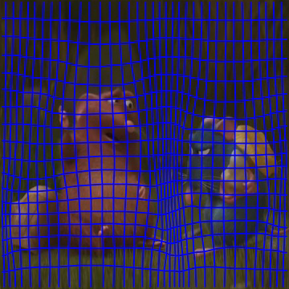
Comparisons
Notes:
Here is Comparison of meshes produced by optimal scale and stretch [WTSL08] and our method when utilizing local similarity constraints only. Even without our extra edge similarity constraints, our method diffuses distortion more uniformly to less important regions.

Slide 21
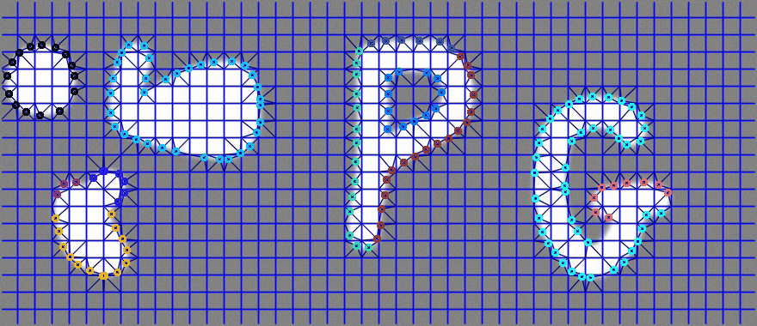
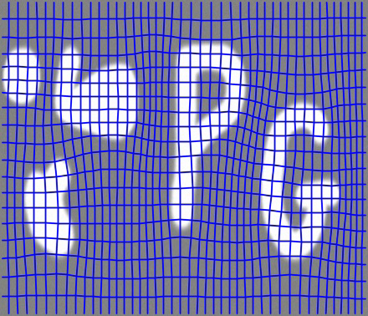
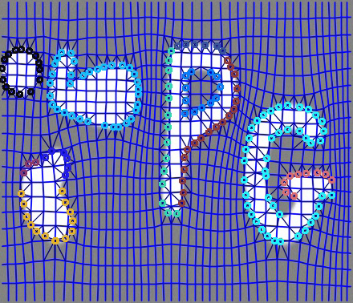
Comparisons
Notes:
This figure illustrates the effectiveness of edge similarity constraints. As shown in bottom left image, edges are not well preserved when using only local constrains. Adding edge similarity constraints in bottom right figure helps to overcome this problem.

Slide 22
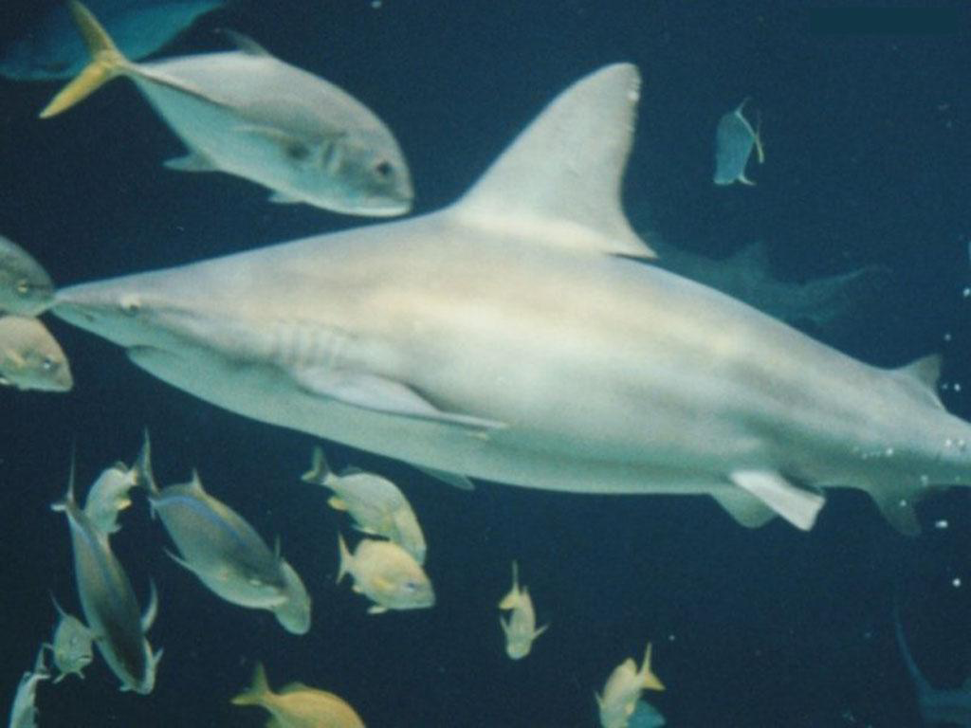

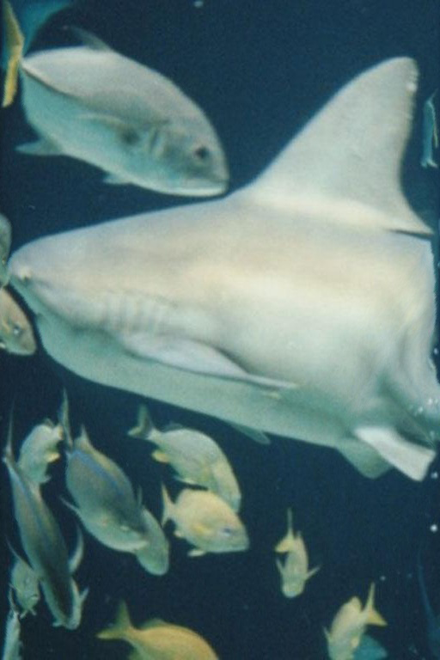
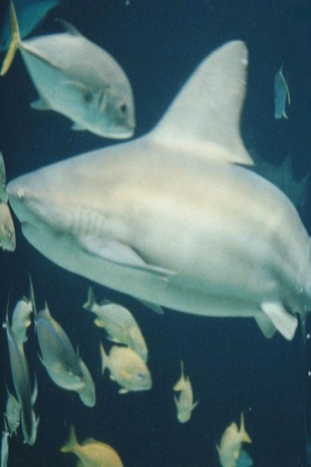
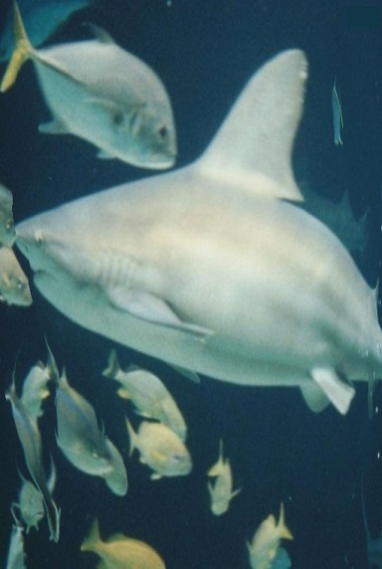
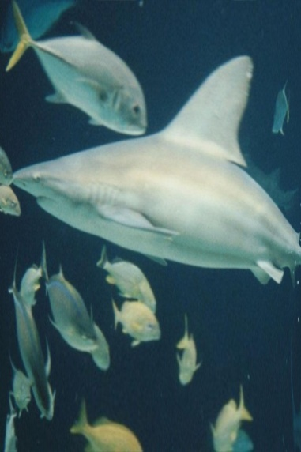
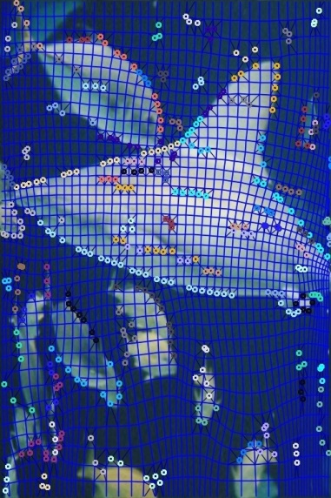
Comparisons
Input image
Scaling
Seam carving
Wolf
Gal
Our
Our
Notes:
Here is another example showing comparisons between our method and other methods which propagate distortions only in 1 direction. Our method preserve the shape of the shark better than other methods since we propagate distortions more efficiently to all directions and preserve some global features.

Slide 23
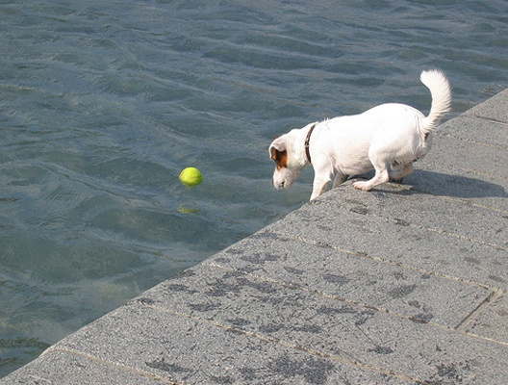
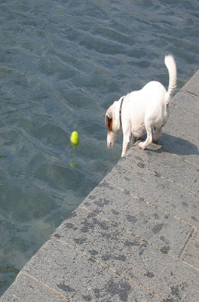
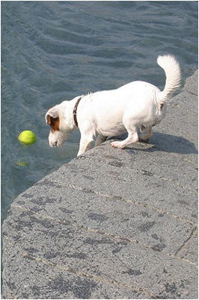
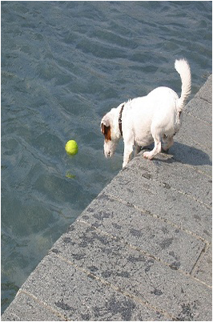
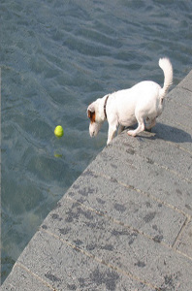
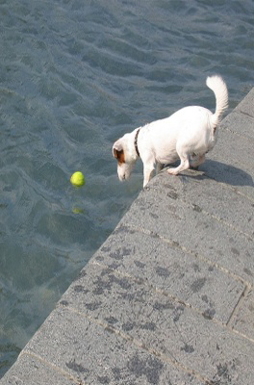
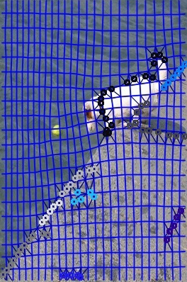
Comparisons
Input image
Scaling
Seam carving
Random walk
OSS
Our
Our
Notes:
In this example, the dog and the riverside is much better preserved by our method than other methods.

Slide 24






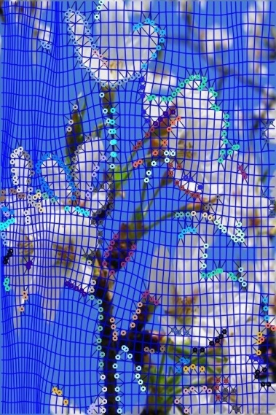
Comparisons
Input image
Scaling
Seam carving
Random walk
OSS
Our
Our
Notes:
Here is another more complex example, notice this flower and this one, our method outperform others since we diffuse distortions more efficiently.

Slide 25
Time Efficiency Comparisons
Method | Seam carving | OSS | Wolf | Random Walk | Our
Time | 1-2s | (0.034+0.002n)s | 5.6s | 0.21s | 0.024s
Image Size | 400×500 | 1024×754 | 1024×754 | 1024×754 | 1024×754
Experimental environment
CPU: 2.33GHz Duo CPU
RAM: 4GB RAM
Notes:
We show the time efficiency comparisons in this slides. Since our method only need to solve a small sparse linear system, it need much less time than other methods. All these experiments are performed on a PC with 2.33GHz Duo CPU and 4GB RAM.

Slide 26
Conclusions
We have the following benefits compared to previous methods
Preservation of both local feature and global feature in a uniform way while previous methods only preserve local image features.
Better distortion diffusion in all directions, we allow a similarity transformation of handles, and the distortions are better diffused.
Our method has an efficient close form global optimal solution which also allows real time processing.

Slide 27
Thanks for Your Attention
Q&A

